Slide 1
System to Software Integrity
a case study
Matteo Bordin Jérôme Hugues
Cyrille Comar, Ed Falis, Franco Gasperoni,
Yannick Moy, Elie Richa

Slide 2
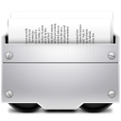
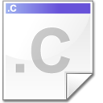
How to verify property preservation?
Peer review
Testing
Design/Verify-by-contract
(Eiffel, Ada 2012, SPARK, Frama-C, …)
Reverse engineering
Automatic code generators
How to combine them?
What about system properties?

Slide 3
a case study
The nose gear challenge

Slide 4
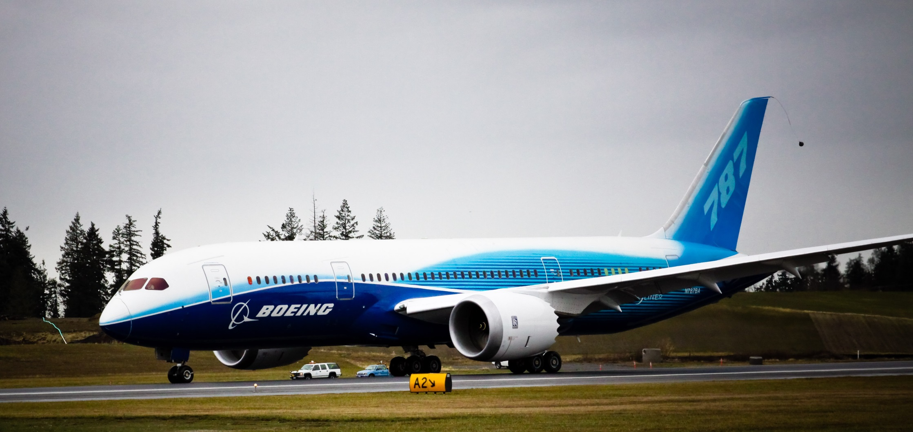
The ground velocity shall be available iff the data used for computation is no older than 3000ms
The measured velocity shall not differ of more than 3 Km/h from the real velocity during the latest 3000ms

Slide 5
From System to Software (top-down only)
AADL
System Model
Property 1
Property 2
…
Property N
Decomposition
SPARK 2014
Simulink
Property 1
Property 2
Property N
Code
Generation
SPARK 2014
Property 2
Property N

Slide 6
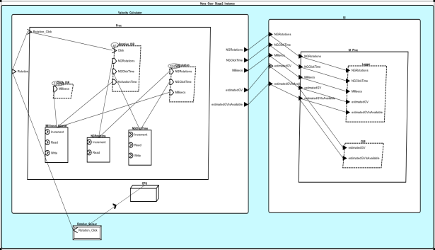
From AADL to Simulink and SPARK
Take advantage of AADL mechanisms to
Describe execution and communication resources (threads, ports, …)
Bind Simulink or Ada functional models to threads as subprograms
First level of V&V done at model-level
Interface are correctly typed, behavior correctly defined as subprograms
Compliance to Ravenscar profile: deterministic concurrency
Schedulability analysis
Consistency: WCET of ISR handlers compatible with # of interrupts
thread implementation Rotation_Sensor_Sim.Impl
subcomponents
calls seq : { C : subprogram Rotation_Sim; };
connections
parameter Simulated_Velocity
-> C.Simulated_Velocity;
port C.Click -> Rotation_Click;
end Rotation_Sensor_Sim.Impl;
subprogram Rotation_Sim
features
Simulated_Velocity : in parameter Velocity;
Click : out event port;
properties
Source_Name => "Rotation_Sim.Rotation_Sim";
Source_Language => (Ada95);
end Rotation_Sim;

Slide 7
From AADL to SPARK
AADL provides full description of use of runtime resources
Use Ocarina to generate code from architectural description
Based on archetypes for concurrency, communication
Ada/SPARK compliant, path to high-integrity software
#5: strong typing, generic, native support for concurrency
#4: restriction for HI systems
#3: restrictions for concurrency: Ravenscar profile
#2: well-known coding patterns
#1: contracts: pre/post conditions
Functional code integrated as external Ada libraries
Preserve abstraction boundaries (typing, encapsulation)
Then connect to integration V&V activities
Compiler checks
100% OK
Best practice
Theorem proving, 90%, on-going

Slide 8
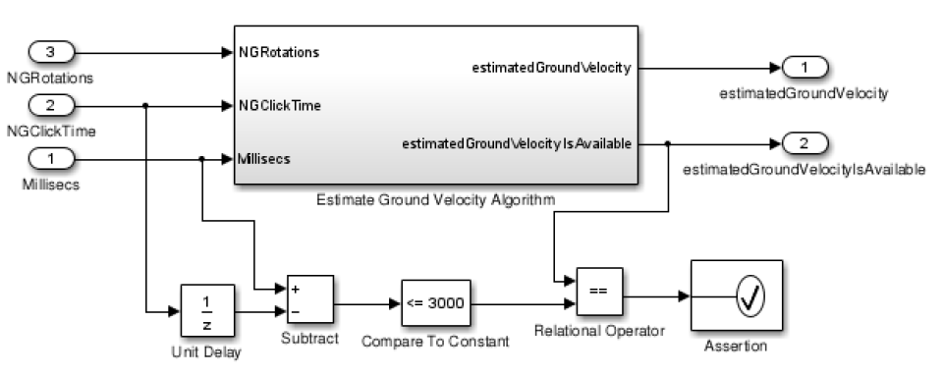
From Simulink to SPARK 2014
Model-level verification (proof + simulation)
...
if Compare_To_Constant_out1 = estimatedGroundVelocityIsAvailable then
Relational_Operator_out1 := True;
else
Relational_Operator_out1 := False;
end if;
pragma Assert (Relational_Operator_out1);
...
Source-level proof or property preservation
Run-time monitoring of safety properties

Slide 9
The wrap-up
AADL
System Model
Property 1
Property 2
…
Property N
Decomposition
SPARK 2014
Simulink
Property 1
Property 2
Property N
Verification by simulation
Verification by formal proof
Code
Generation
SPARK 2014
Property 2
Property N
Verification
by formal proof

Slide 10
TAKE HOME
messages

Slide 11
Property preservation: how?
Several different techniques
Peer review, testing, automatic code generation, formal proof, …
How to combine them?
While providing evidence of coverage
And taking into account system-level concerns
Use AADL as a pivot representation
Derive formalized specifications downstream
Rely on languages supporting design-by-contract
AADL, SPARK, Simulink Assertion Blocks, …
And translate them across abstraction layers

Slide 12
Current state & future improvements
SPARK 2014 Formal Verification Toolset
Currently in Beta, first release in April 2014
Simulink to SPARK 2014 code generator
Project P, available in Q4 2014
AADL to Ada/SPARK2014 code generator + runtime
Part of Ocarina distribution, available through http://www.openaadl.org
Tested with GNATProve GPL 2013

Slide 13
thanks!
Matteo Bordin, bordin@adacore.com
Jérôme Hugues, jerome.hugues@isae.fr
Cyrille Comar, AdaCore
Ed Falis, AdaCore
Franco Gasperoni, AdaCore
Yannick Moy, AdaCore
Elie Richa, AdaCore

